Slide 1
VOCABULARY
1

Slide 2
a figure to be feared: a person to be feared
Glad sense of relief: feeling relaxed
Fainter and fainter: to lessen or reduce
slip down: come down quietly and unwillingly
Stutter: to stammer, to speak with pauses
given it up: stopped doing it

Slide 3
Trying so hard: making a lot of efforts
Wretched: unhappy, sad
on the brink of suicide: about to commit suicide
suicide: kill oneself
Snoring: the sound produced by some people when there are asleep
Gravely: seriously.

Slide 4
Laboriously: with lot of effort or difficulty.
Wandered into: went into, by chance
Scraps: small pieces of cloth or paper etc that are not needed.
Hue and Cry: angry protest.
The damned thing: used to express anger at something.

Slide 5
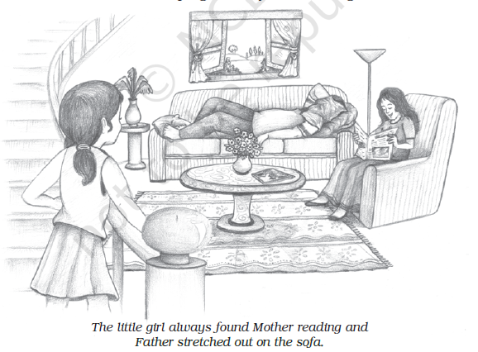

Slide 6
Clung: to attach yourself to something.
Nightmare: a bad dream.
A Butcher is a person who cuts animals, who cuts meat.
tucked up: covered up nicely in bed
Snuggled: moved into a warm, comfortable position, close to another person

Slide 7
